Slide 1
Project 3
Rachel Weber

Slide 2
Background
The Data:
26,489 patients
6 consecutive six-month periods.
height, weight, BMI, albumin levels, ASA, procedure code, and death within 30 days
The Objective:
To identify whether certain VA hospitals have an unusual death rate from heart surgeries compared to a hospital-level risk-adjusted estimate of mortality
Report observed death rate for the most recent 6 month period
Understand variation in death rates given historic data

Slide 3
Missingness
 | Survived N = 25,259 | Died N = 693
 | N(%) | N(%)
Procedure
0 | 4,951(20) | 102(15)
1 | 20,308(80) | 591(85)
Missing | 0(0) | 0(0)
ASA
2 | 1,130(4) | 13(2)
3 | 7,718(31) | 102(15)
4 | 14,473(57) | 485(70)
5 | 1,301(5) | 66(10)
Missing | 637(3) | 27(4)
 | Mean(SD) | Mean(SD)
Weight (lbs.) | 165.8(36.03) | 174.3(38.24)
Missing (N%) | 620(2) | 40(6)
Height | 65.33(2.625) | 65.51(2.575)
Missing (N%) | 620(2) | 40(6)
BMI | 28.2(4.010) | 29.49(4.058)
Missing (N%) | 622(2) | 40(6)
Albumin | 4.041(0.5798) | 4.031(0.5574)
Missing (N%) | 12,623(50) | 343(49)
Albumin had extremely high amounts of missingness
Expected due to recent utility
There was no pattern of missingness with regard to:
BMI
ASA
Procedure
Death at 30 days
6% died with missing. 4% died with measure
Pattern allowed for no adjustment in modeling procedure
Models with and without albumin were fit for comparison

Slide 4
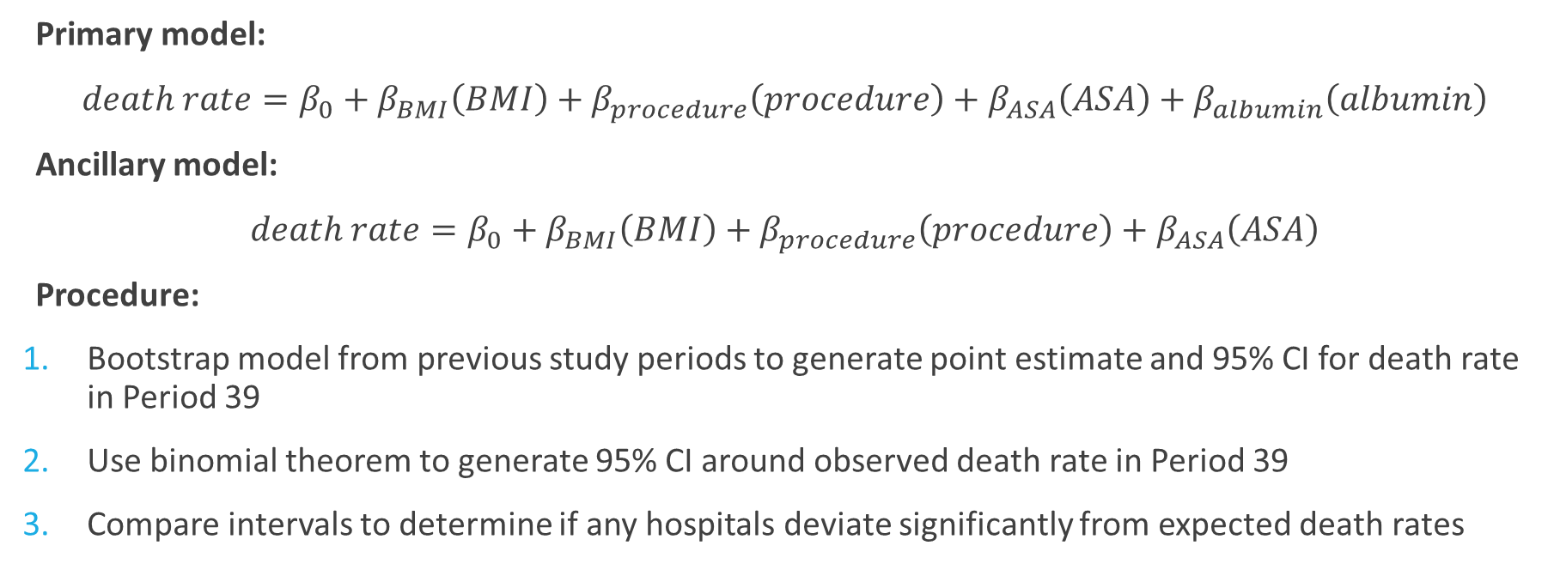
Modeling
Primary model:
$death rate=β_{0}+β_{BMI}\left(BMI\right)+β_{procedure}\left(procedure\right)+β_{ASA}\left(ASA\right)+β_{albumin}\left(albumin\right)$
Ancillary model:
$death rate=β_{0}+β_{BMI}\left(BMI\right)+β_{procedure}\left(procedure\right)+β_{ASA}\left(ASA\right)$
Procedure:
Bootstrap model from previous study periods to generate point estimate and 95% CI for death rate in Period 39
Use binomial theorem to generate 95% CI around observed death rate in Period 39
Compare intervals to determine if any hospitals deviate significantly from expected death rates

Slide 5
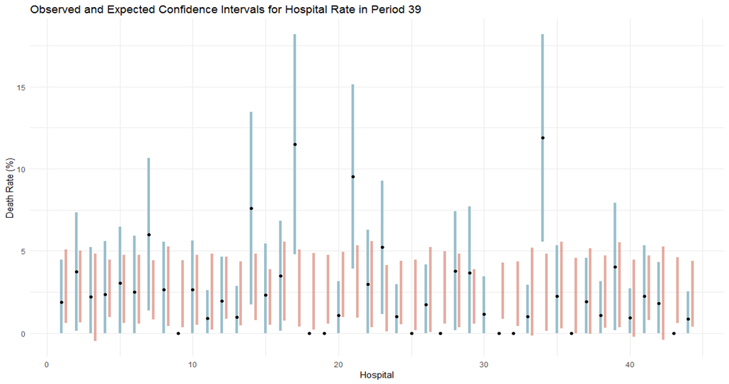
Results
Observed 95% CI
Expected 95% CI
Observed rate

Slide 6
Results
14
.0214
Observed 95% CI
Expected 95% CI
Observed rate
7
.0362
17
<.0001
21
.0013
34
<.0001

Slide 7
Main Takeaways
Hospitals 9, 18, 19, 25, 27, 31, 32, 36 and 43 all had no deaths in period 39!
Hospitals 7, 14, 17, 21, and 34 all had unusually high death rates
Though albumin was missing in nearly 50% of the data, its missingness was at random
The model that included albumin gave more realistic confidence intervals

